Slide 1
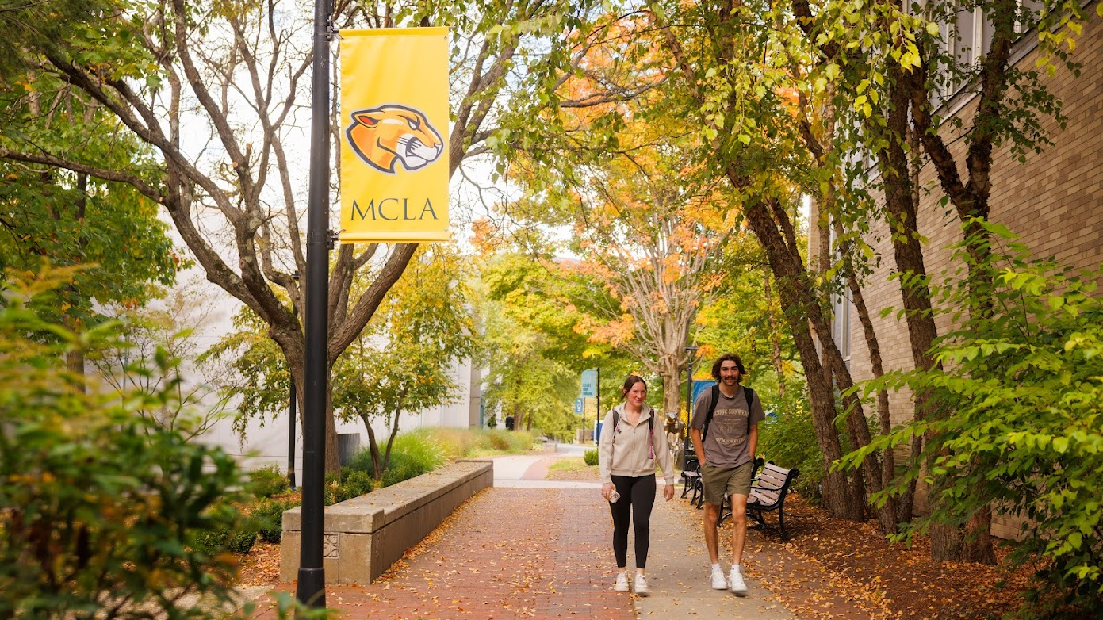
MCLA Strategic Planning 2025-2030
February 2026 Update

Slide 2
Institutional Planning Timeline
2021 - 2028
Pathways Campaign
2021-2026
NECHE 10 Year Review
2022-2032
Strategic Planning
2025-2030
Strategic Facilities Planning
2025-2026
NECHE Interim Report
2027-2028

Slide 3
Overview
Opportunities, challenges, and achievements
“Guided by our distinctive public liberal arts mission, this strategic plan reflects MCLA’s deep commitment to academic excellence, innovation, and belonging. The plan represents a call to action, urging us all to challenge assumptions, think creatively about our work, and act strategically in pursuit of our shared goal of making MCLA a stronger, more accessible and student-centered institution.”
-President James Birge

Slide 4
Participation
Nearly 600 community members participated in the
strategic planning process with close to 1000 data points
collected
Over 75 community members are actively participating in
the rollout of the strategic plan
Project leaders are engaging additional offices and campus colleagues in their work creating an inclusive process

Slide 5
Plan Highlights
Distinctive liberal arts mission
Increase access and belonging
Enhance the student voice and experience
Goal 1: Distinctive liberal arts mission: The College will position itself to effectively make key institutional decisions regarding all aspects of campus functions, including enrollment, academic programming, mission, and vision
Goal 2: Increase access, belonging, and success: The College will ensure that growth in diversity, equity, and belonging stays at the forefront of all institutional actions and decision-making
Goal 3: Enhance the student voice and experience: By proactively leveraging current strengths and focusing on building a more positive experience for students, the College can simultaneously address enrollment and retention

Slide 6
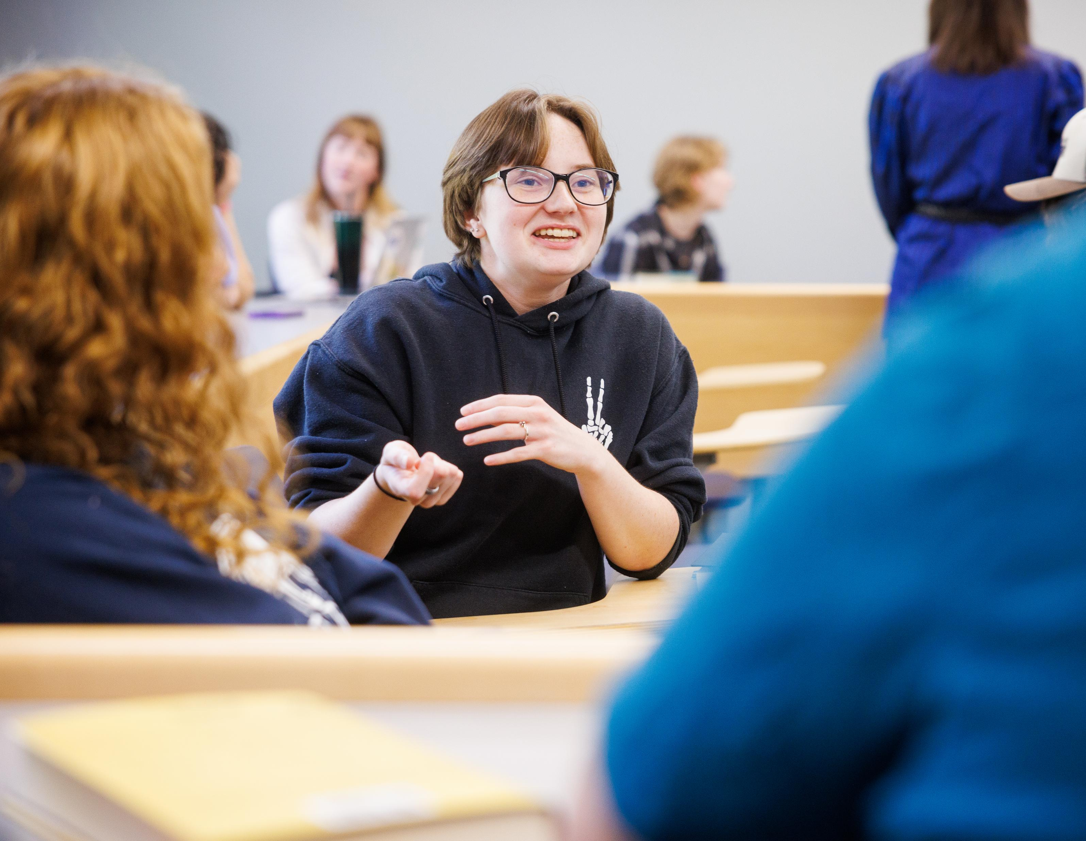
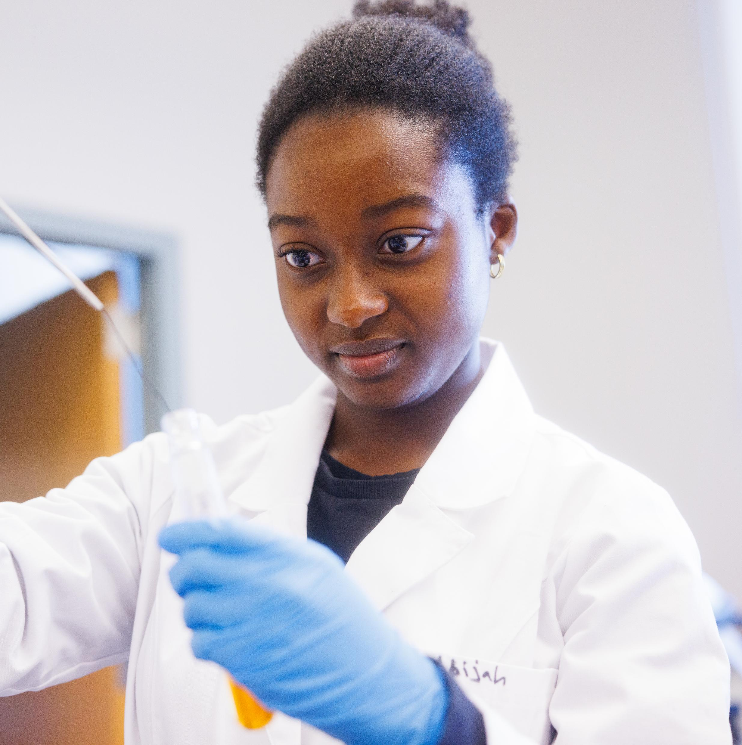

Goal 1: Liberal Arts Mission
Hired ADV to conduct market research
Identified a 15-member working group to revise mission, vision, and value statements
Strategic budget group developing budget plan tied to enrollment
Working on strategies to better utilize institutional, state, and federal student aid to support students and enhance recruitment
Conducted a full institutional website audit and optimization initiative making it dynamic and fully accessible
Moved from decentralized, ad hoc social media activity to a centrally managed, strategic institutional model
Launched personalized communications initiative to reduce summer melt and improve transfer conversion
Notes:
Market research by ADV embedded in most of this work. Data to come soon, will help shape identity, compared to other institutions and what strikes a never with people

Slide 7
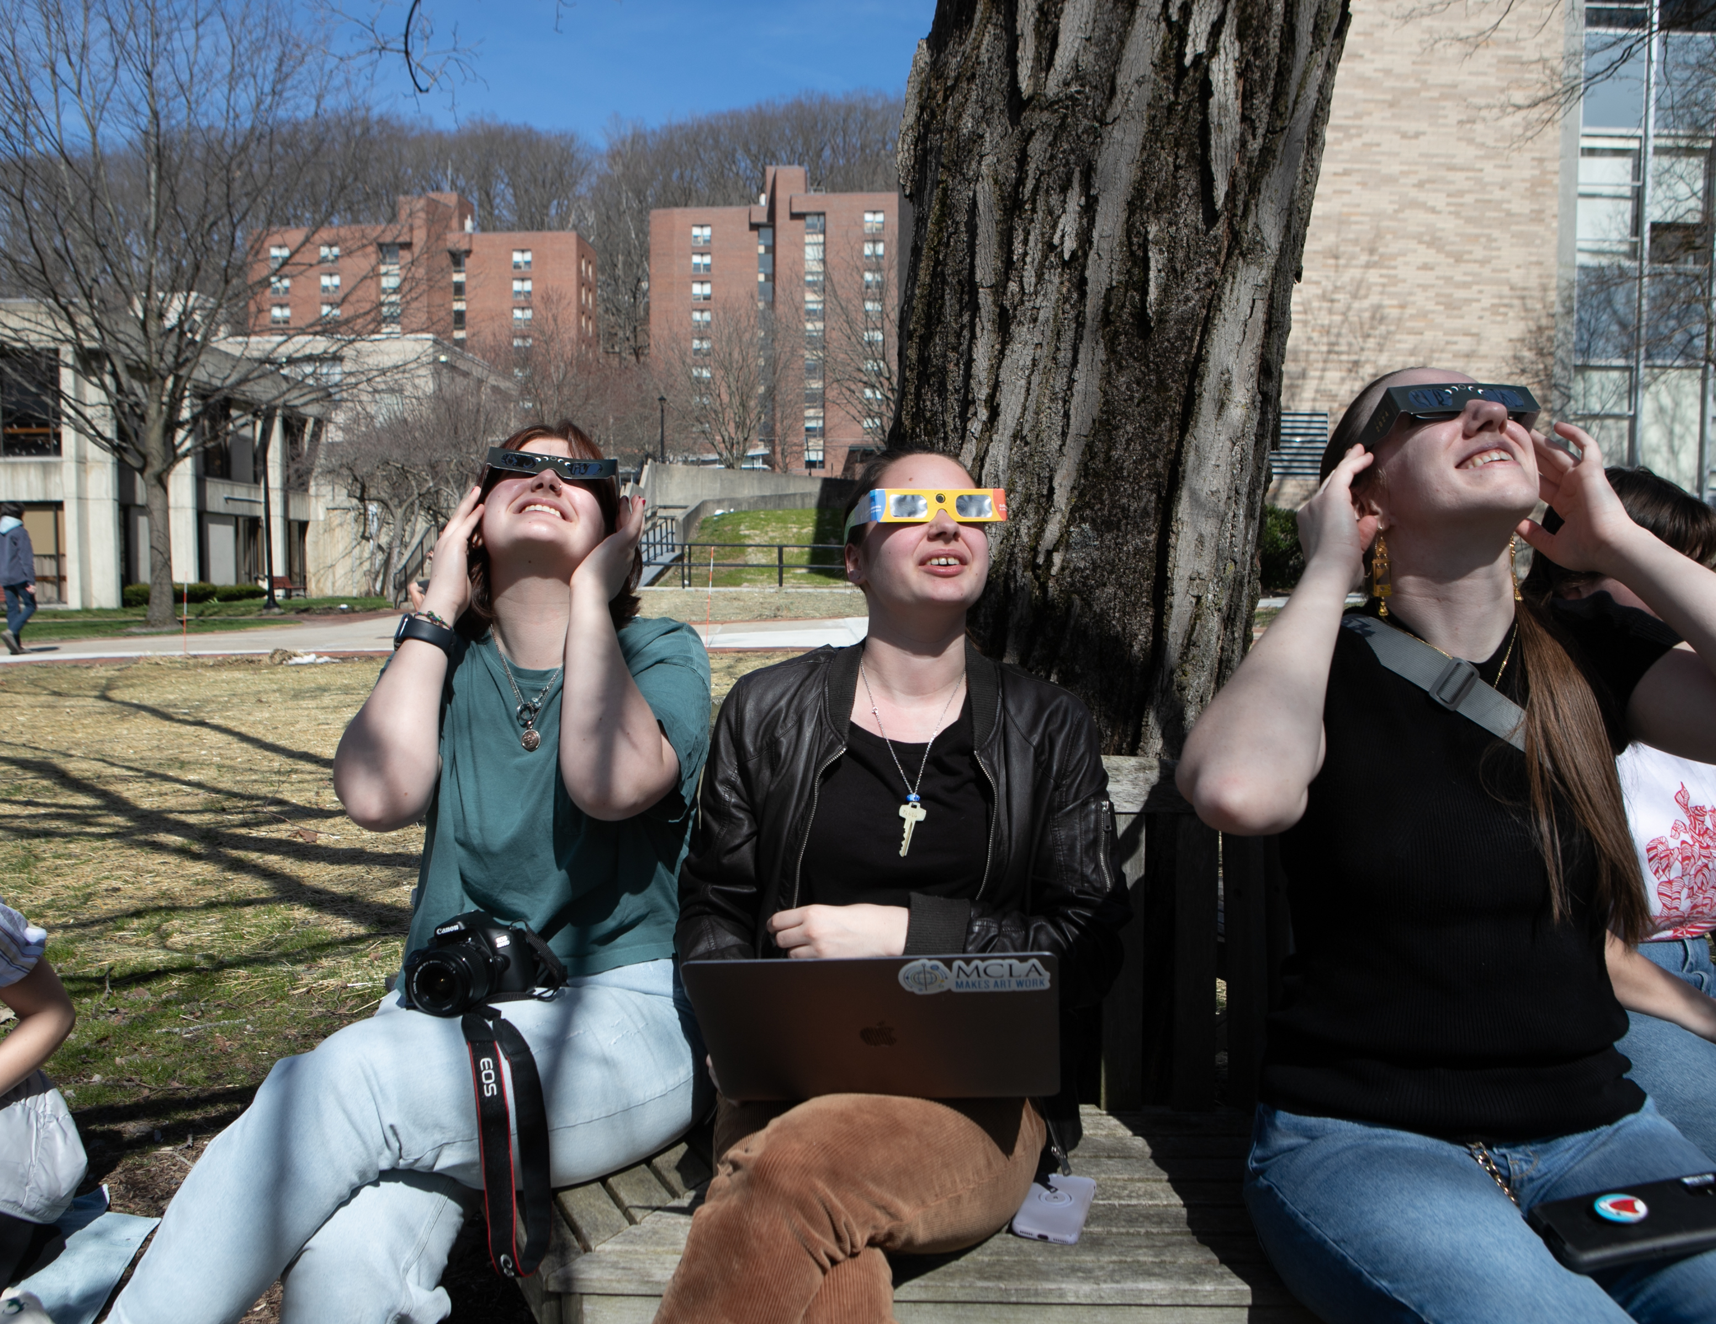
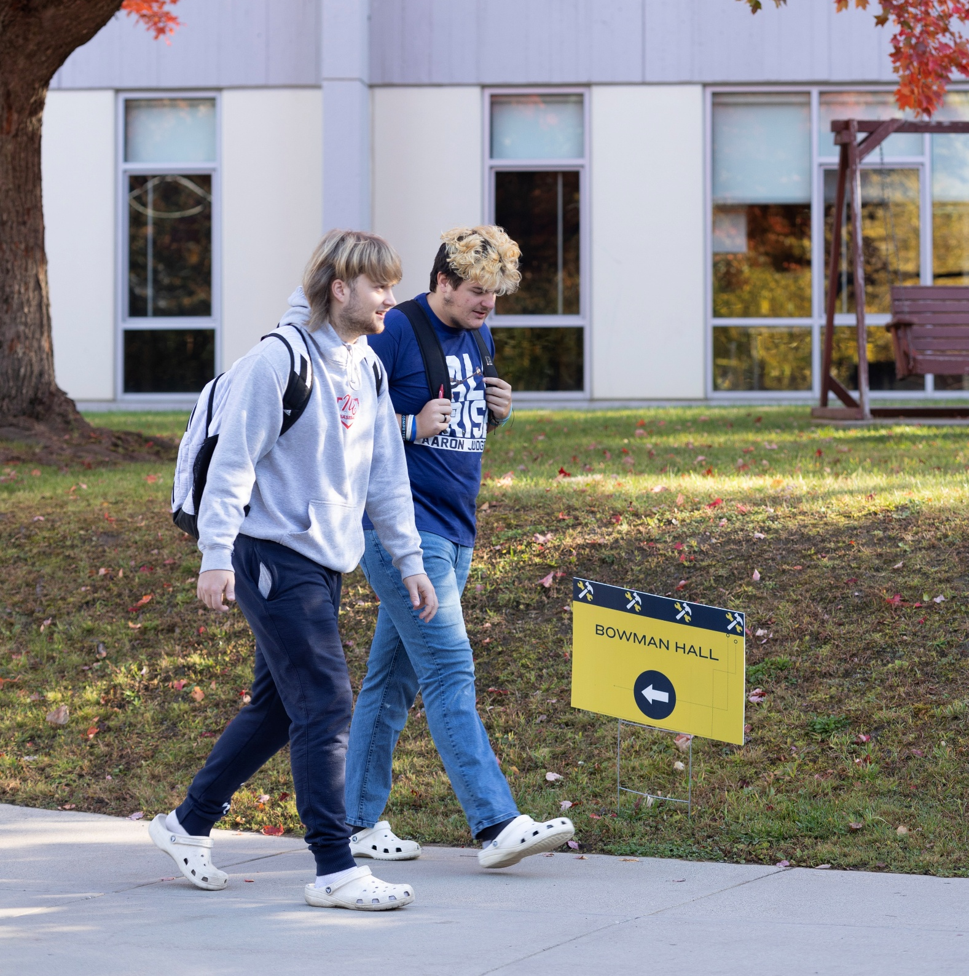
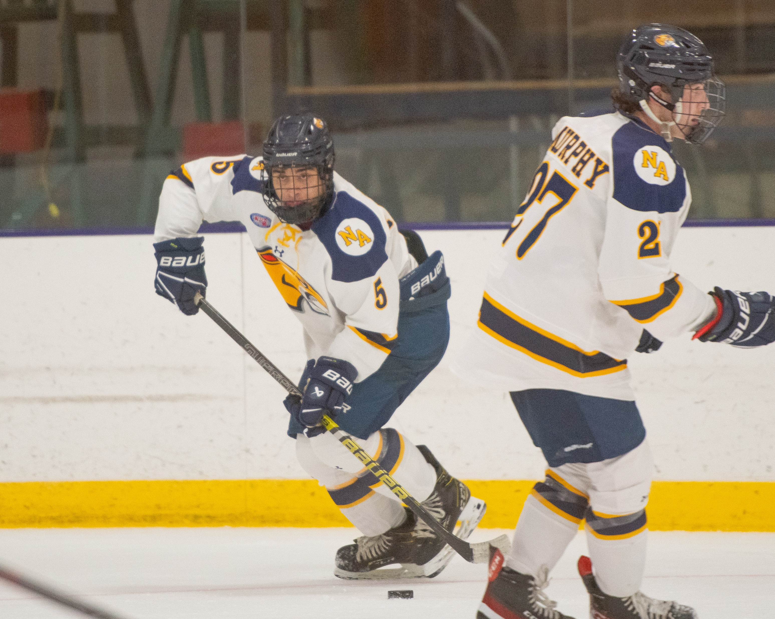
Goal 2: Increase Access and Success
Diversity, Equity, Inclusion, and Belonging Council makeup, charge, and SMART goals have been developed
Hiring a travel and study abroad specialist for the Trombley-Westall Trailblazer Center
Spring travel courses planned and scheduled
Developing transportation plan for access to local High Impact Practices (HIPs)
Utilized SUCCESS and TRiO funding to hire 4 positions dedicated to student achievement
Piloted a library textbook loan and expanded textbook reserve program this spring
Working with the Mayor’s programming consultants and North Adams Public Schools Superintendent to plan professional development and volunteer opportunities
Notes:
Spring travel courses: Brazil, South Africa, Ireland, London, Civil Rights Bus Tour; South Africa and London are fully supported by donors. We have lots of scholarships available for students. Jeannette is co-leading the civil rights bus trip
Spencer is also running his service trip to Belize as well
Staff hires: Director of Academic Advising, Assistant Director of New Student Programs & First Gen, Assistant Director of Academic Advising and Support, Director of TRiO
Advancement funds will be used to support hiring in the Trombly-Westall center
LEAH group from Boston coming to campus, interested in furthering stem education

Slide 8
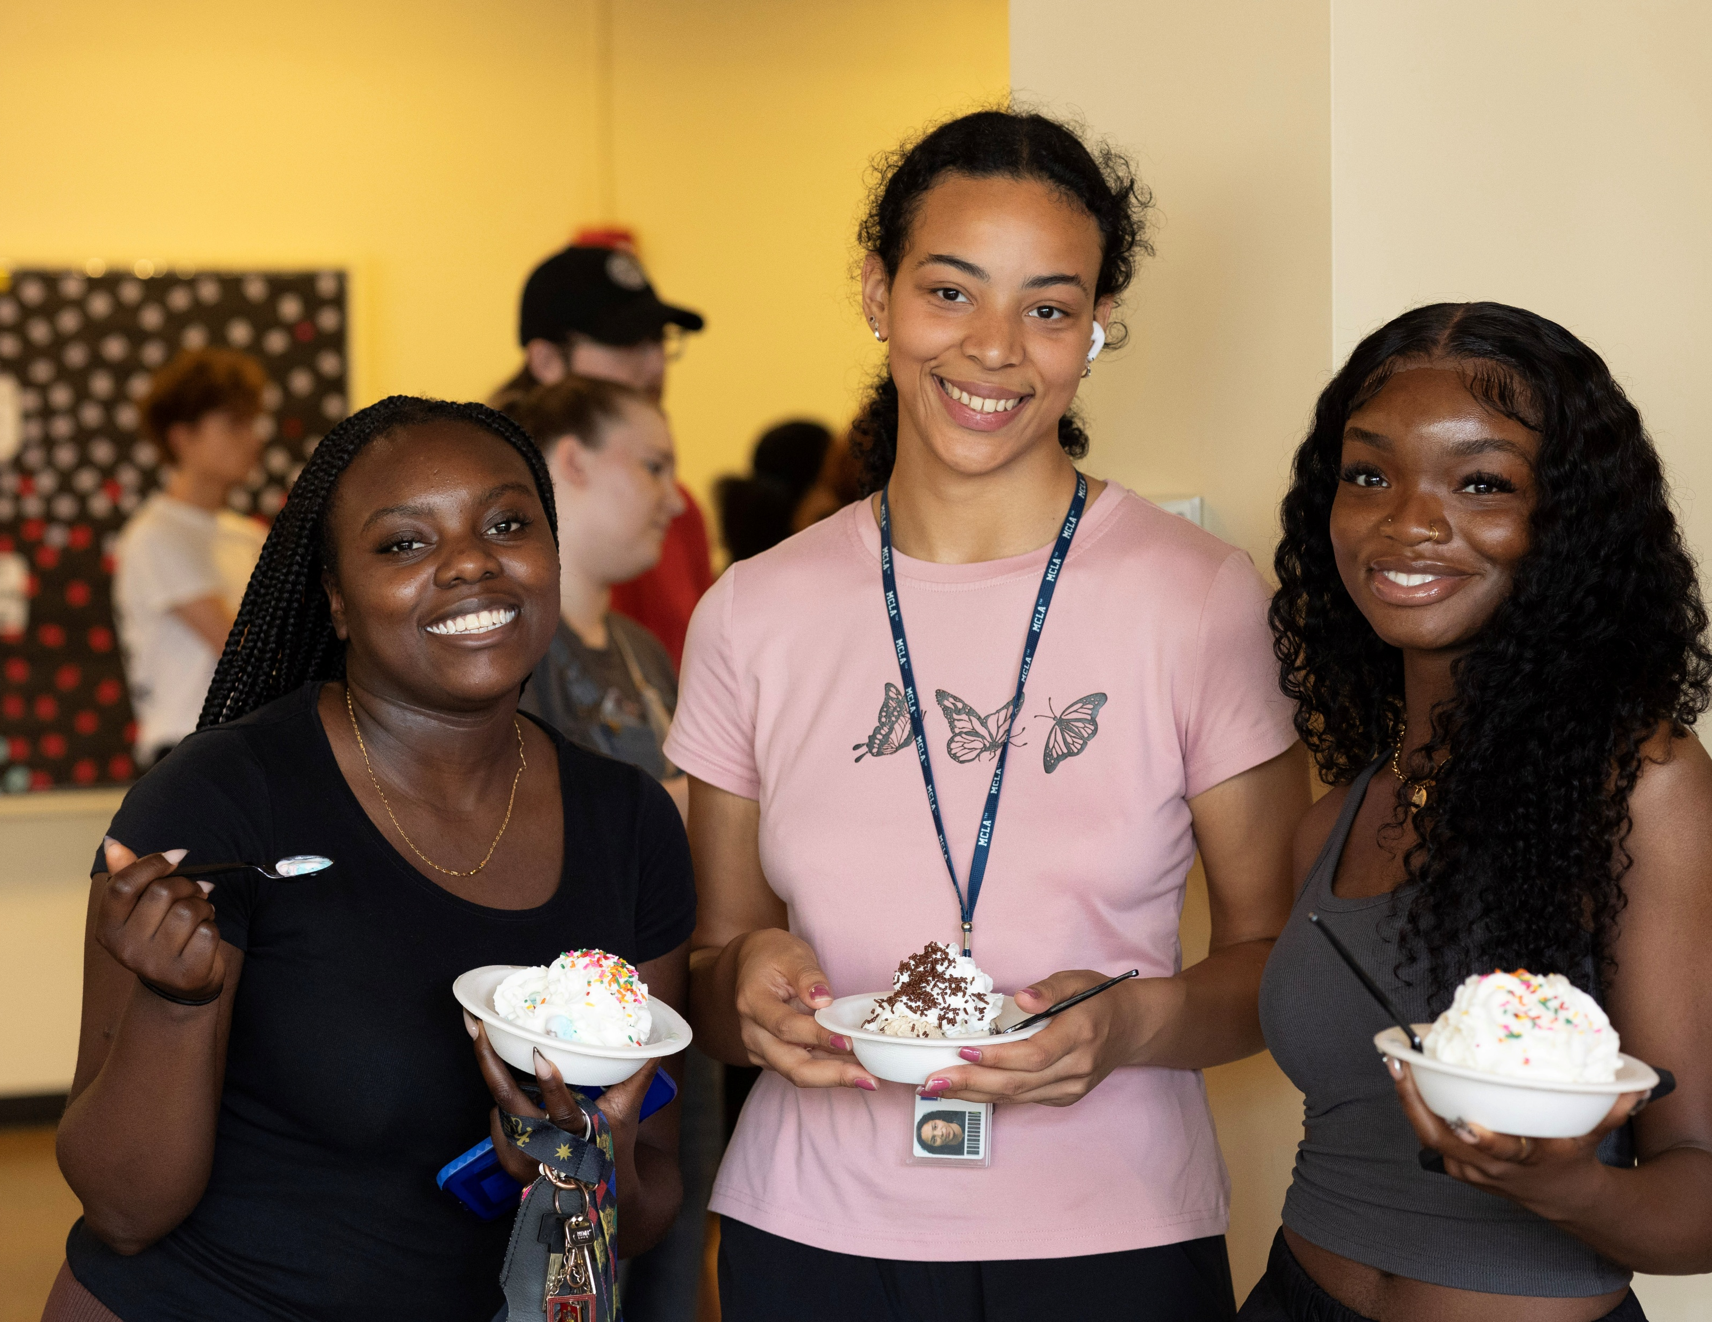
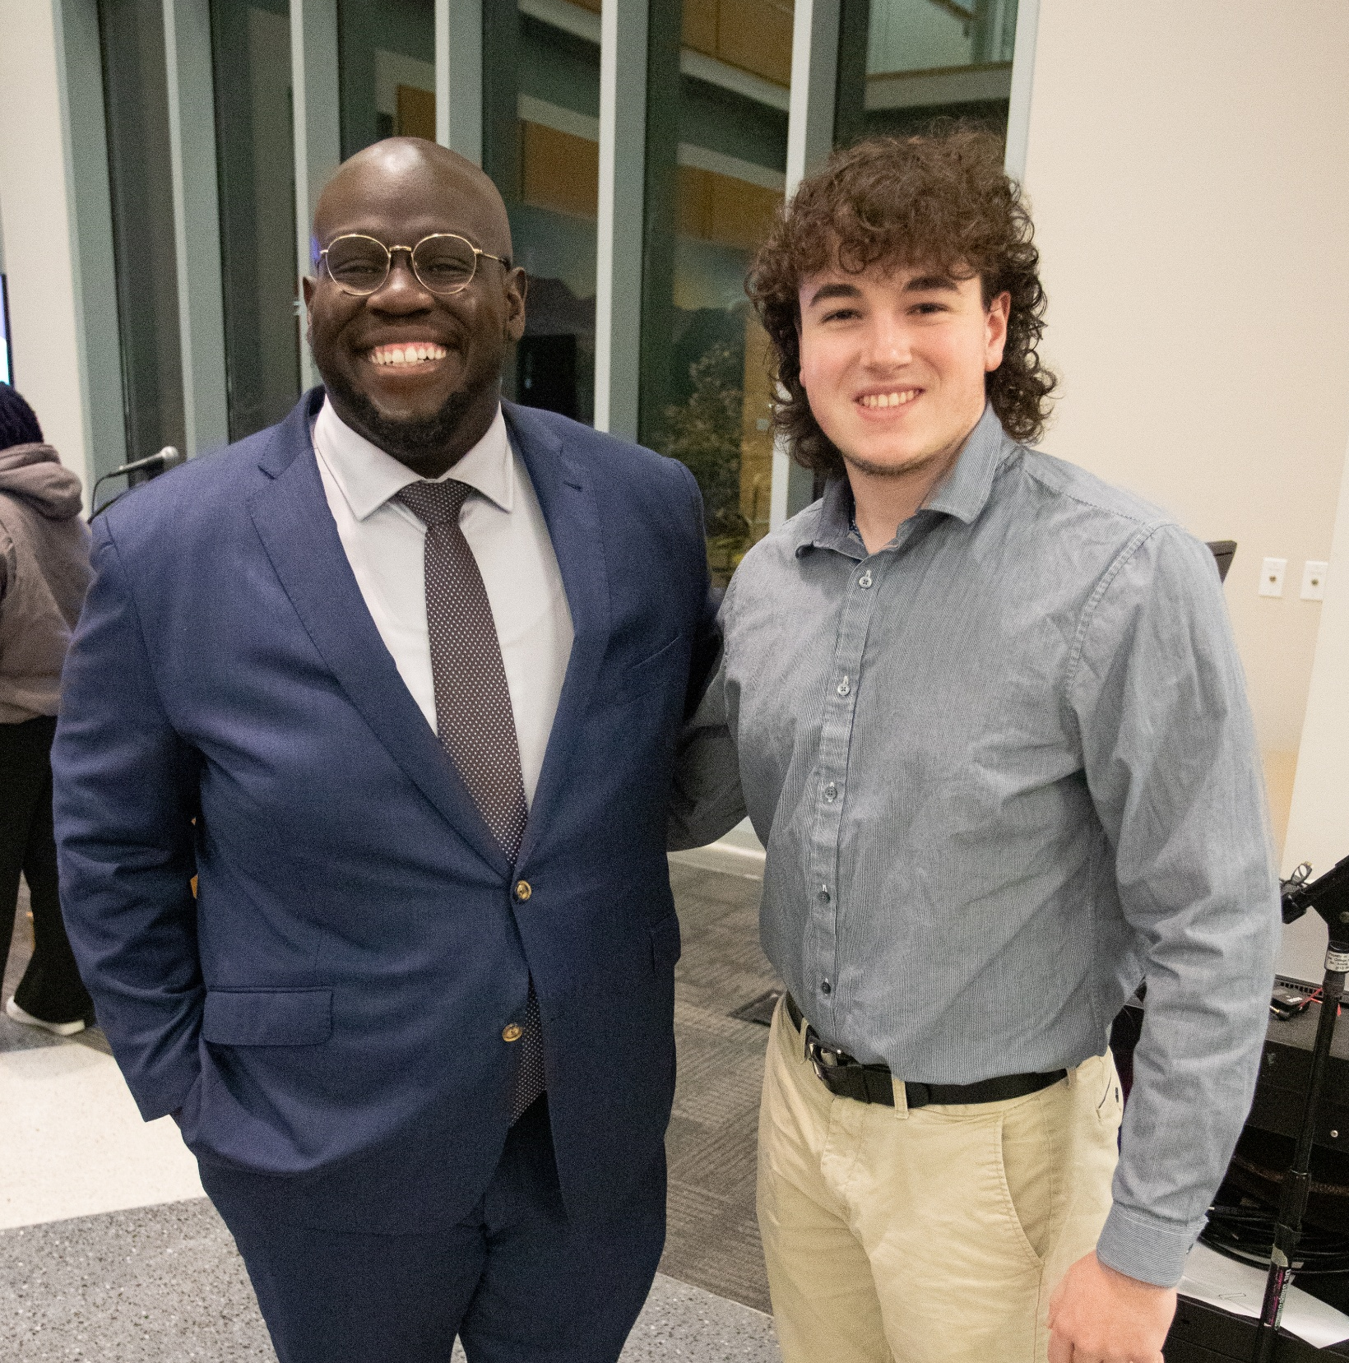
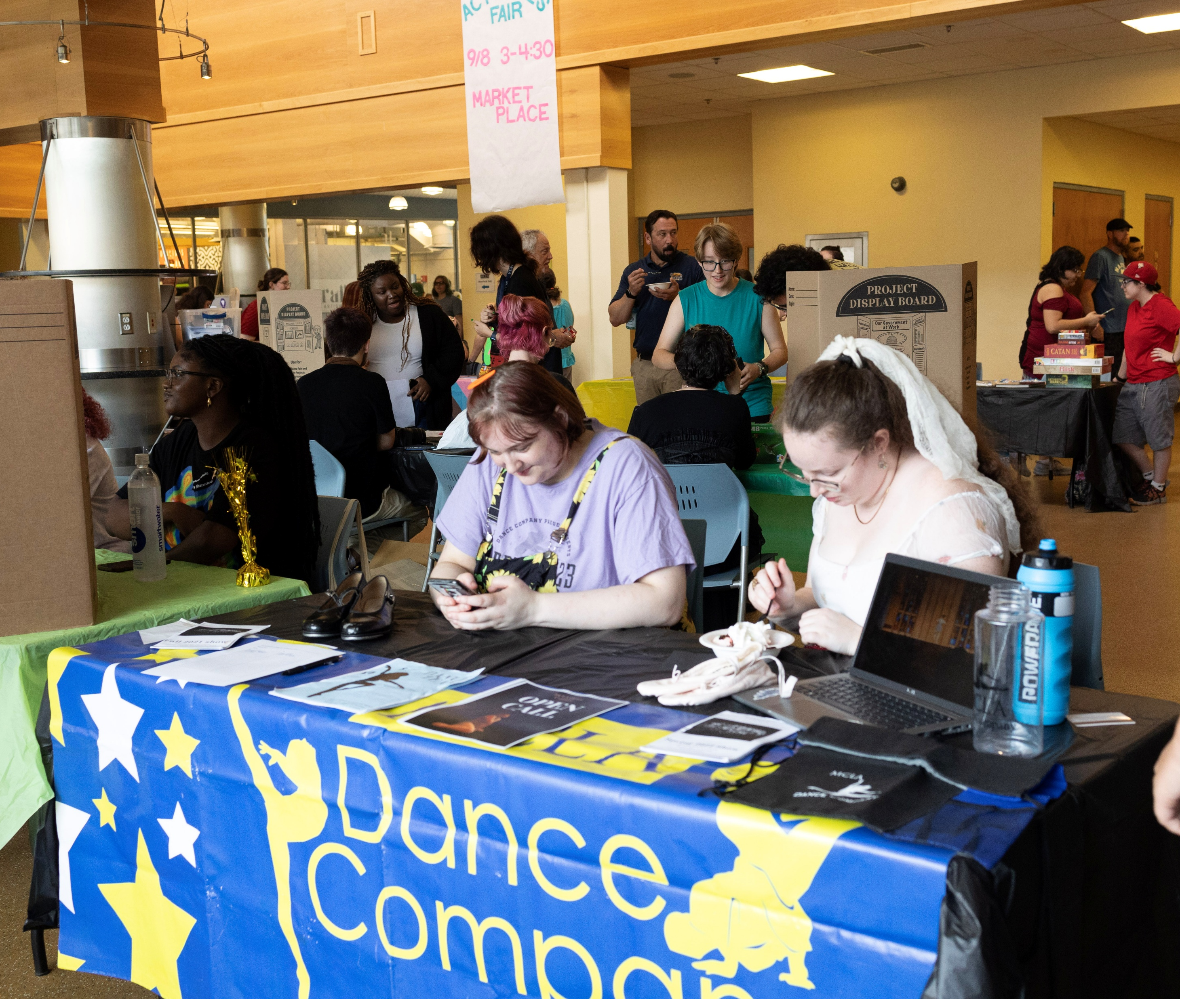
Goal 3: Enhance the Student Voice and Experience
Drafting an institution wide inclusive definition for student leadership
Expanding, and incentivizing student leadership opportunities with an eye towards equity
Building out experiential transcript to track student milestones and accomplishments
Developed Strategic Facilities Plan to guide renovation and construction
Adding additional late night and weekend programming to build community and expand social opportunities
Refreshed commuter spaces to be more welcoming and beneficial

Slide 9
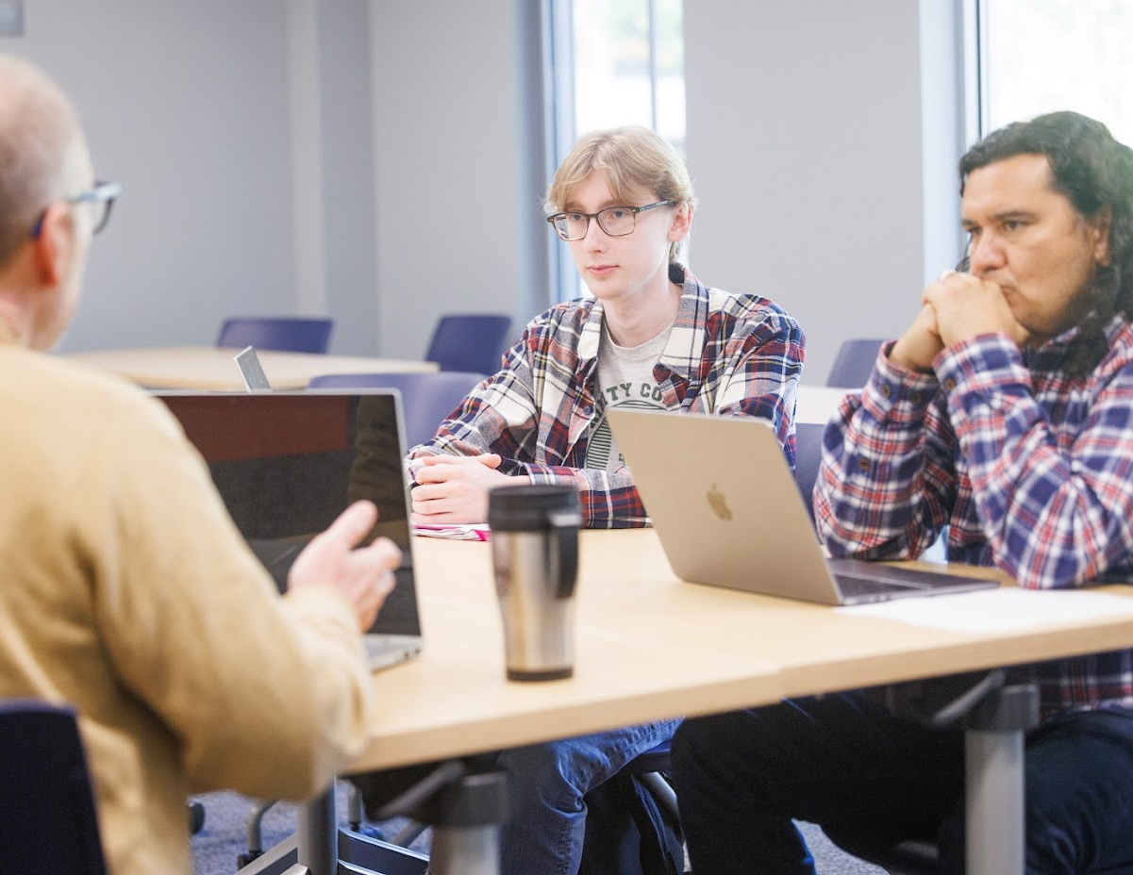
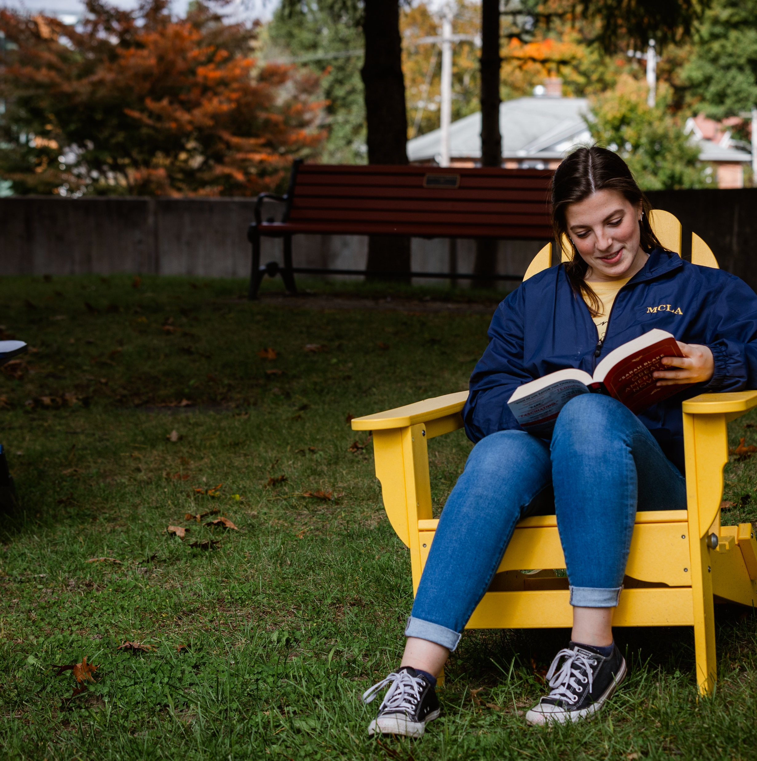
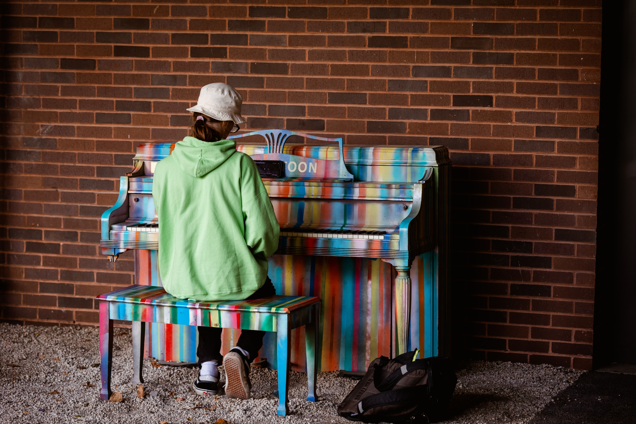
Financial Update
Board budget is regularly monitored to ensure appropriate spending
On track to spend down appropriate Board funds by June 30th
Tracking SUCCESS funds to ensure funds are utilized to support student success and engagement
Beginning to build the FY 27-28 budget for Strategic Planning

Slide 10
“I am confident that we will work together as a community to advance these goals and enhance the positive impact MCLA already has – on our students and their families, our 21,000 alumni, our faculty and staff, our city and the region, as well as the Commonwealth.”
James Birge, Ph.D.

